Slide 1

Customer Shopping Behavior Analysis
Uncovering spending patterns, customer segments & product preferences from 3,900 transactions
RETAIL ANALYTICS
PYTHON · SQL · POWER BI

Slide 2
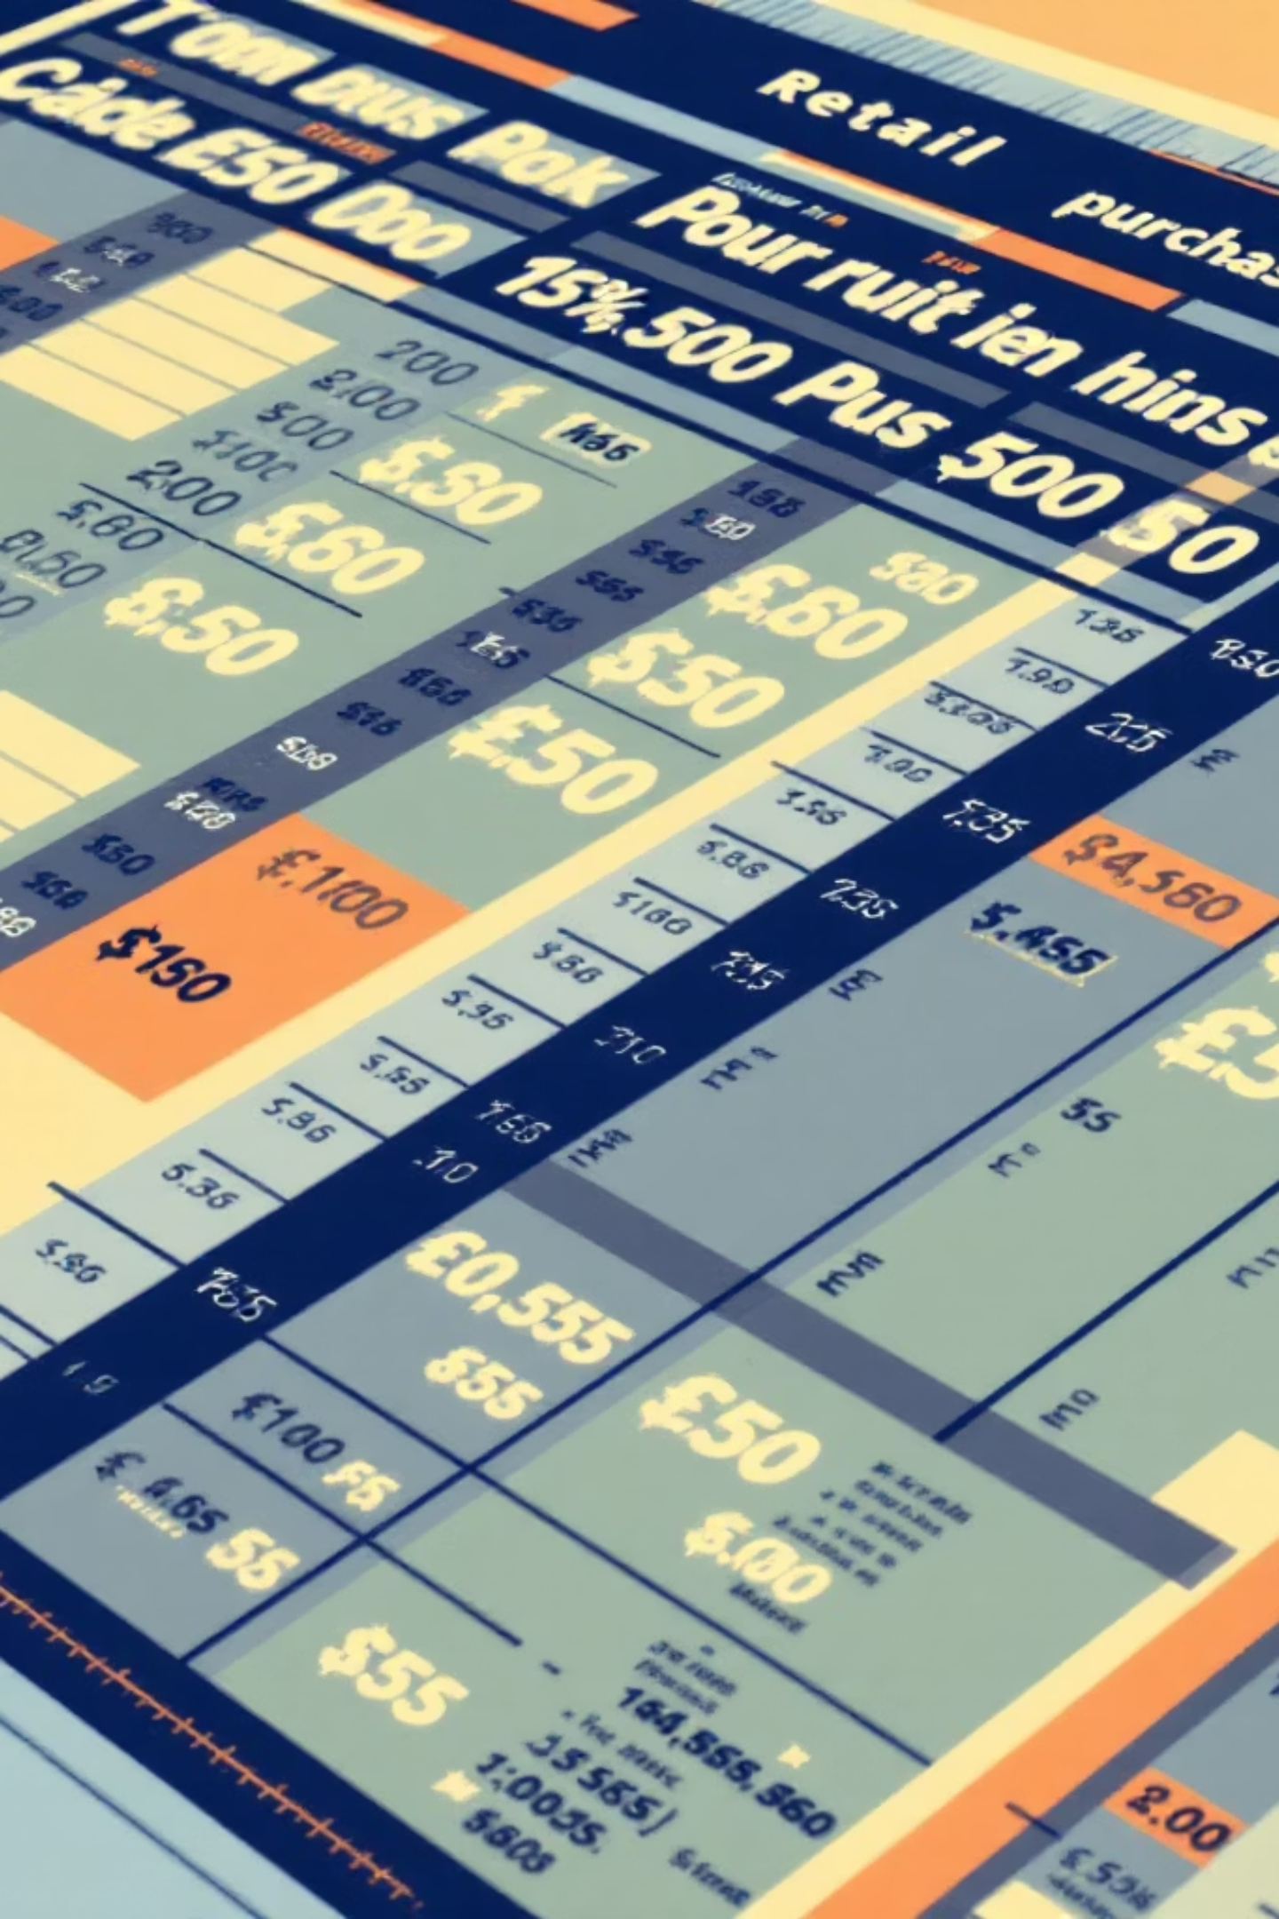
Dataset at a Glance
3,900
18
4
Purchases
Features
Categories
Demographics · Purchase details · Shopping behavior · Subscription status

Slide 3

Data Preparation in Python
01
Load & Explore
pandas import, df.info() & .describe()
02
Clean & Standardize
Imputed missing ratings · Renamed to snake_case
03
Feature Engineering
Created age_group & purchase_frequency_days
04
Load to PostgreSQL
Connected Python to DB for SQL analysis

Slide 4
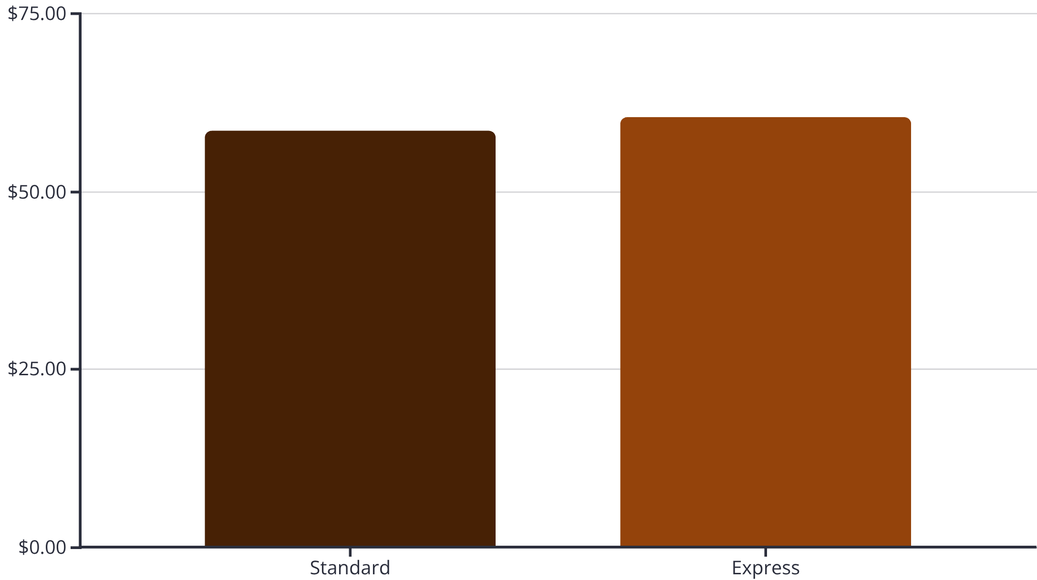

Revenue & Shipping Insights
Express Buyers Spend More
Express shipping customers average $60.48 vs. $58.46 for Standard — a signal of higher-intent shoppers.
Target express-shipping users for premium product campaigns.

Slide 5

Subscribers vs. Non-Subscribers
Only 27% Subscribe
Non-subscribers generate $170K total revenue vs. $62.6K for subscribers — a major growth opportunity.
Avg spend is nearly identical (~$59.70), meaning volume is the key differentiator.
Subscribed
Non-Sub

Slide 6

Customer Segments
3,116
701
83
Loyal
Returning
New
>5 purchases
2–5 purchases
First purchase

Slide 7
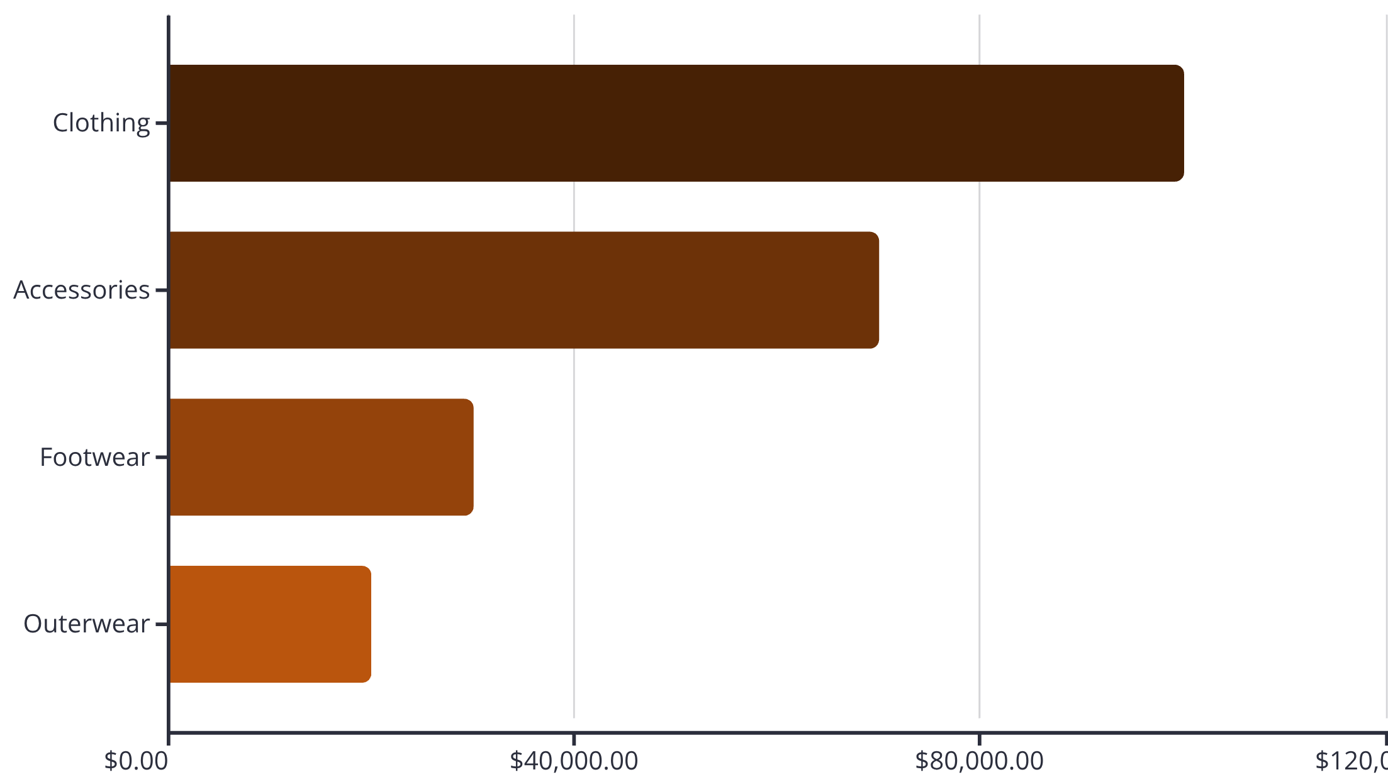
Top Products by Category
Accessories
Jewelry · Sunglasses · Belt
Clothing
Blouse · Pants · Shirt
Footwear
Sandals · Shoes · Sneakers
Outerwear
Jacket · Coat

Slide 8
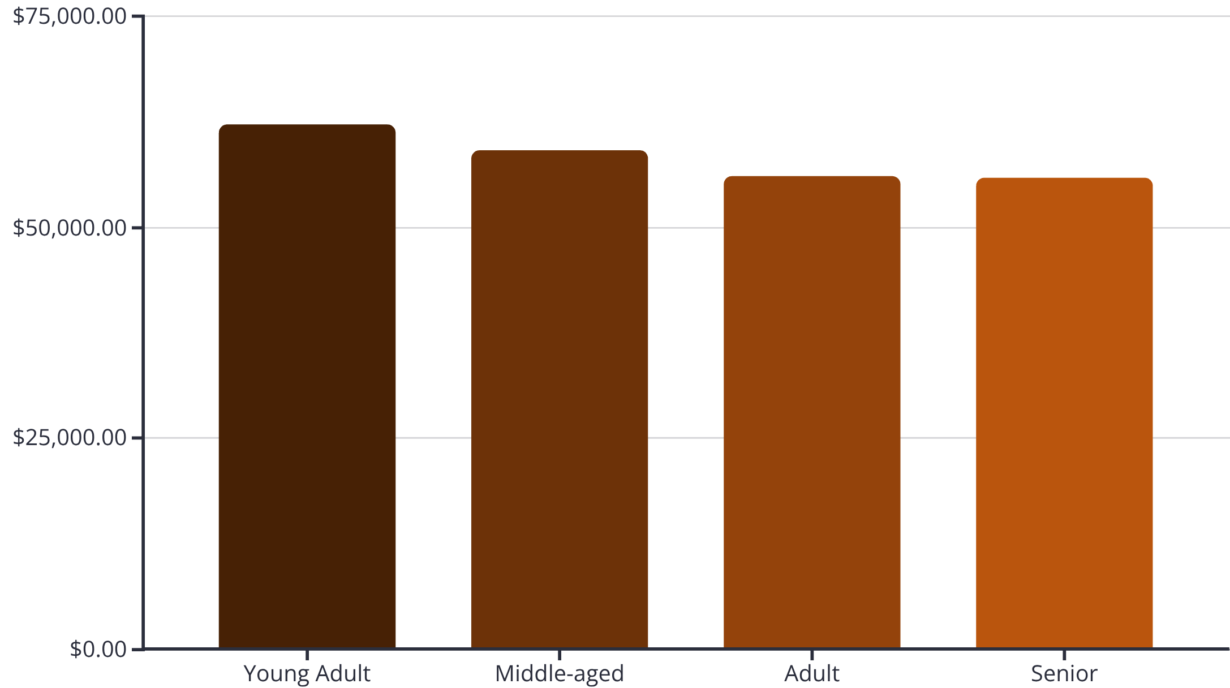
Revenue by Age Group
Young Adults Lead Revenue
Young Adults contribute $62K — the highest of all groups. Revenue is relatively balanced across all age segments.
All age groups are valuable; tailor messaging rather than excluding any segment.

Slide 9

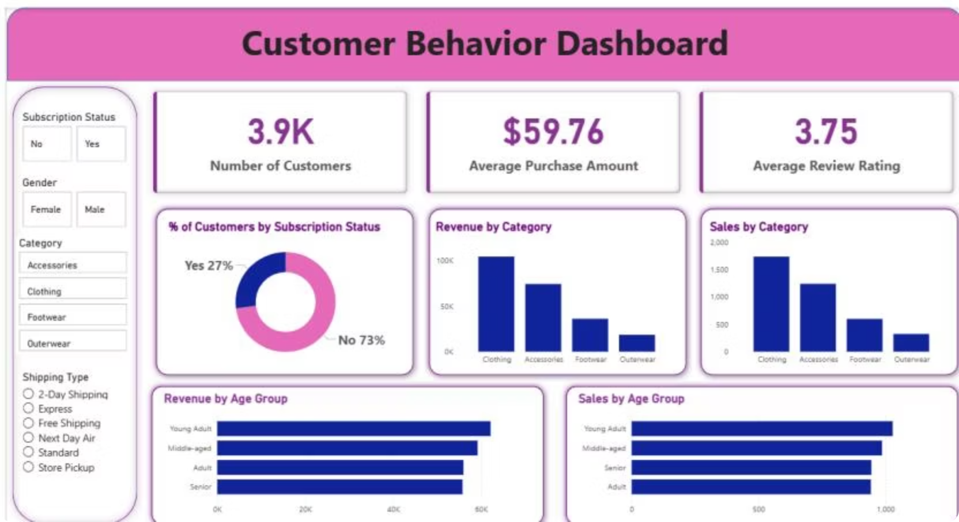
Power BI Dashboard
Interactive dashboard combining subscription status, category revenue, age group sales, and gender filters in a single view.

Slide 10


Business Recommendations
Boost Subscriptions
Promote exclusive subscriber benefits
Loyalty Programs
Reward repeat buyers → move to Loyal segment
Review Discount Policy
Balance sales boosts with margin control
Targeted Marketing
Focus on high-revenue age groups & express-shipping users

